Slide 1

Module 1.6 Extended software concepts

Slide 2
Contents
Integrated software
Licensing agreements
Free software!
System software
Test and improve
Written module activity

Slide 3
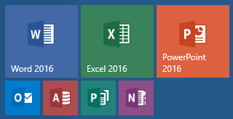
integrated software
Advantages:
Separate packages have a similar interface
Separate packages designed to share and exchange data
Sold as a suite of programs – one purchase
Example of integrated software
Microsoft Office:
Notes:
Before the idea of Graphical User Interfaces (GUIs), programs looked very different (they had a different interface). It was therefore quite hard to learn how to use a new program. It was also very difficult to share data between these programs.

Slide 4
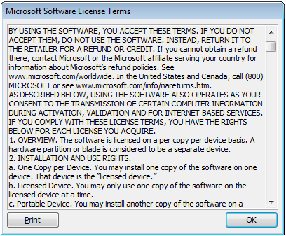
Licensing agreements
These are actually legally binding contracts between you as the user and the software company. These license agreements are often termed EULAs or End-User Licence Agreements
1. OVERVIEW. These license terms permit installation and use of one copy of the software on one device, along with other rights, all as described below.
2. INSTALLATION AND USE RIGHTS. Before you use the software under a license, you must assign that license to one device. That device is the “licensed device.” A hardware partition or blade is considered to be a separate device.
a. Licensed Device. You may install and use one copy of the software on the licensed device.
b. Portable Device. You may install another copy on a portable device for use by the single primary user of the licensed device.
c. Separation of Components. The components of the software are licensed as a single unit. You may not separate the components and install them on different devices.
Notes:
Interesting fact: You are allowed to install your software on your PC and another portable device (laptop). It is important to read your licence agreements carefully.

Slide 5
Licensing agreements
Software piracy
Illegal installation, copying and distributing of proprietary software.

Most software now requires activating or registering online in an attempt to crack down on software piracy.
Software piracy is a crime and can result in hefty fines or even jail time!

Slide 6
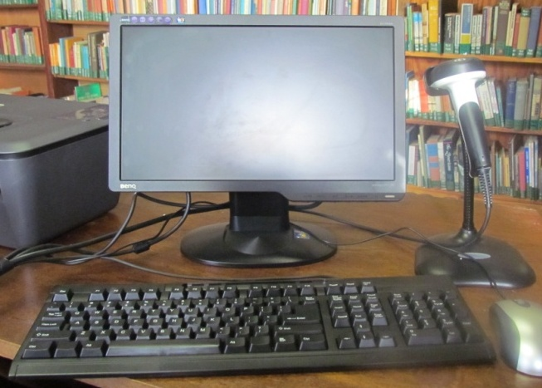
Licensing agreements
Single user licence
This generally means that you may only install ONE copy of the software.
You can also usually make one backup copy of the media (CD or DVD) that contained the software.

Slide 7
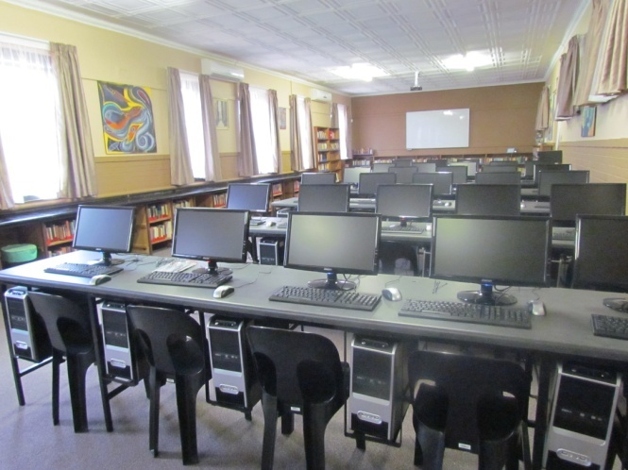
Licensing agreements
Site licence
Unrestricted number of installations within the company or organisation
More expensive than a single licence, but cheaper than buying single copy for each computer
(Also referred to as Volume licencing)

Slide 8
Free software
Freeware and Shareware
FREEWARE
Fully functioning software that can be used and copied without any restrictions
SHAREWARE
Software that you can download free and use for a trial period for free. After the trial period, or to get the ‘full’ version, you need to pay for it.

Slide 9





Free software
Open source software (OSS)
Software that may be freely used, modified and distributed, but not sold.
Examples of open source software:
Linux operating system
Office suites OpenOffice and LibreOffice
Java programming language
MySQL database system
Notes:
Open source software may be altered, but cannot be sold. The support and documentation can be charged for (it is the source code that is free).

Slide 10
Free software
Open source software – cont.
Potential disadvantages of open source software:
No guarantee of quality or that it works correctly
Often many different versions of the same product
Can generally only get it from the internet – downloads can use a lot of data and take some time
Not as widely used
Documentation and support may not be easy to access

Slide 11
Free software
©
Copyright
Copyright: refers to the legal right to make copies, publish and sell.
Intellectual property: broader concept – recognises the ownership of the person that came up with the original idea or thought.
Creative Commons: non-profit organisation that promotes the sharing and free use of knowledge and products legally

Slide 12

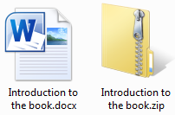

System software
Utility programs
Compression software
Used to make a compressed (smaller) version of a file

Slide 13
Activity 1
Compressing files and folders
Notes:
Purpose of this exercise:
The learners practice compressing and unzipping files and folders using utility software.

Slide 14

System software
Utility programs
Backup utilities
Backing up our files regularly is essential, because…
files can be accidentally deleted or overwritten
files can become corrupt by not shutting down properly, power failures or computer viruses
storage devices (disk drives) can fail

Slide 15
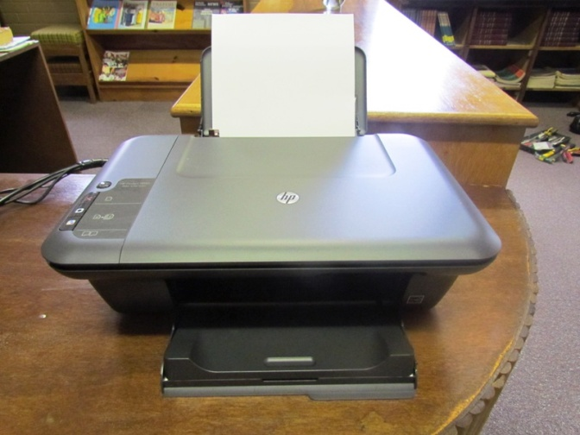
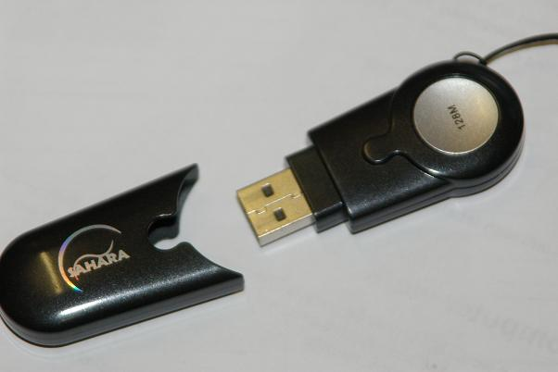
System software
Drivers
Every piece of hardware – from a flash drive to a printer – is controlled by a driver.
A driver is software that allows your computer to communicate with hardware or devices.

Slide 16
Test and improve
Integrated software
Licence Agreements
Free software
System software

Slide 17
Written module activity

